Slide 1




Implementing Causal Machine Learning in Tuesday: Causal Machine Learning & Optimal Policy
August / September / October 2024
Michael Lechner Professor of Econometrics | University of St. Gallen | Switzerland

Slide 2
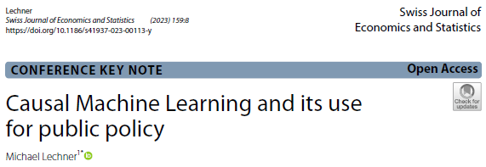
The workshop series | 1
4 online workshops
August 27, 14³⁰-16³⁰: Correlation & causation
September 3, 14³⁰-16³⁰ : Available identification strategies & classical estimation
September 10, 14³⁰-16³⁰ : Machine Learning
September 11, 14³⁰-15³⁰ : The data for the Astana workshop & useful descriptive statistics

Slide 3
The workshop series
Astana Workshop September 30 to October 4, 2024 (10-13, 14:00-17:30)
Monday
Morning: Identification with experiments & selection on observables
Afternoon: Discussion of potential programmes to be evaluated
Today: Causal Machine Learning (theory) (ends at 16:00)
Wednesday
Empirical examples: Active labour market programmes in Flanders
The mcf package – how to use it & how to interpret the results
Thursday: Empirical study in groups with the data introduced in online workshop 4
Friday: Discussion of programmes to be evaluated continued (core team only)

Slide 4
Quick introduction
Participants
Professional background?
Knowledge in the estimation of causal effects, machine learning, Python?
Myself
Professor of Econometrics at the University of St. Gallen
Co-head of The Swiss Institute for Empirical Economic Research at the University of St. Gallen
Empirical Economic Research | SEW-HSG | University of St.Gallen (unisg.ch) www.michael-lechner.eu
Research interest in Causal Machine Learning, AI, programme evaluation, …

Slide 5
Today
Causal machine learning estimators
Machine Learning vs Causal Machine Learning
Double Debiased Machine Learning (Chernozhukov et al., 2018)
Causal Trees & Forests
The seminal Causal Forest of Wager & Athey (2018)
Generalized Random Forest (Athey, Tibshirani, Wager, 2019)
Modified Causal Forest (Lechner, 2018)
Pro’s & con’s of these estimators (Lechner & Mareckova, 2024)
Asymptotics
Finite sample properties
Optimal Policy

Slide 6

1 | Introduction
2 | Machine Learning vs Causal Machine Learning
3 | Double Debiased Machine Learning
4 | Causal Trees & Forests
5 | A comparison of Comprehensive Causal Machine Learners
6 | Optimal Policy & Algorithmic Decision Making
7 | Conclusions & outlook

Slide 7
Machine learning meets econometrics
Already discussed in online workshop 3
ML & econometrics have different goals
Goal of machine learning
Get best guess of y once you know x → learn (=estimate) f(x)
Carefully ensure that estimated f(x) does not depend on unobservables (i.e. avoid in-sample overfitting)
Goal of econometrics
Learn parameters capturing how a change in x changes y
Get respective uncertainty measures for these causal parameters
Examples: regression coefficients, average treatment effects, other ‘structural’ parameters
y = f(x) + unobservables

Slide 8
How to compare estimators? SL/ML
Already discussed in online workshop 3
Goal: Reliable prediction (& classification)
Limited interest in inference
How to: Use many reference data sets
Split data in estimation data (e.g., used for estimation)
Compare predictive performance relative to true values in test data
Test data has not been used at all for estimation
Many references to such data sets can be found at
https://en.wikipedia.org/wiki/List_of_datasets_for_machine-learning_research

Slide 9
How to compare estimators? Econometrics (causal analysis)
Already discussed in online workshop 3
Goal: Estimation of a parameter
Comparison of prediction with true parameter is impossible in real data
Therefore, statistical guarantees are important (valid whatever the data & true effect)
Therefore, evidence of finite sample performance important
Usually done with simulation studies in which true effect is known (i.e. specified by researcher)
Reference data sets exist, but they also contain simulated components (as true effect is unknown)
Therefore, in a particular application, inference is most important to understand relevance of estimated effect

Slide 10
Classical Econometrics & Machine Learning
Already discussed in online workshop 3
This table oversimplifies (a bit)
Issue | Classical econometrics | Supervised statistical learning
Target of interest (θ) | Structural & causal parameters (low dimensional) | Prediction (Ey|x) or classification of y
Sample analogue of θ | -- | y
Judging quality of estimation | Indirect (fit, …), in-sample | Direct $\hat{(y}$ vs y), out-of-sample
Inference & theoretical properties | Very important | Less important (irrelevant?)
Sample size (N) | Large N is nice to have | Large N may be required
# of variables (k) | Much smaller than N | Smaller or larger than N
Preferred model complexity | Simple, likely to be parametric (linearity popular) | Complicated (overparametrized; nonlinear)
Names of methods | Boring | Cool

Slide 11
Notation | Binary treatment
Already discussed in online workshop 3
Binary treatment as simplification
D Treatment
Y⁰ Potential outcome for D=0
Y¹ Potential outcome for D=1
Y = D Y¹ + (1-D) Y⁰
X All confounders & heterogeneity variables
Z Specific heterogeneity variables (low dimensional; included in X)
Sample contains i.i.d. realisations of D, Y, X

Slide 12
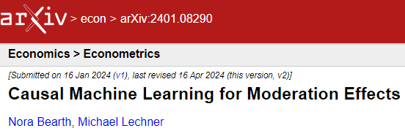
Estimands of mean causal effects at different aggregation levels | 1
Individualized (Conditional) Average Treatment Effect (IATE(x), CATE(x))
Group Average Treatment Effect (GATE(z),CATE(z))
Balanced Group Average Treatment Effect (BGATE(z))
Average Treatment Effect (ATE)
GATEs & ATEs on the treated / non-treated

Slide 13
The estimation problem | 1
Naïve ML estimator
ML estimation of E(Y|X=x, D=d) in treated (d=1) & non-treated subsample (d=0)
IATE(x): Predictions of Y for treated - predictions of y for non-treated
GATE(h) : Average IATE(x_{i}) with h_{i} same/similar to h
ATE: Average IATE(x_{i})
Naïve estimator may be a bad idea
Predictions of ML estimators are usually biased
MSE optimal-prediction of E(Y|X=x, D=d) but inference may not work (too much bias)
Estimating a difference well is different from estimating its components well
Only difference of estimation errors matters

Slide 14
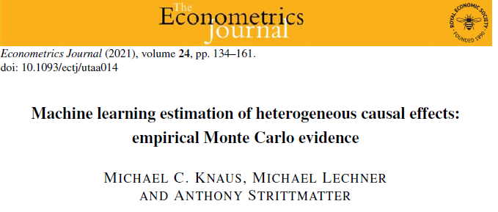
Estimators | 1 (see Knaus, Lechner, Strittmatter, ’21)
Generic approaches (à la Knaus, Lechner, Strittmatter, 2021)
Modify outcome & use standard ML (Section 4)
1st: Signorovitch (2007), PhD thesis Harvard
Modify covariates & use standard ML (Section 4)
1st: Tian, Alizadeh, Gentles, Tibshirani (2014, JASA)
Modify ML algorithms directly
CART → Causal Trees
Su, Tsai, Wang, Nickerson, Li (2009, Journal of Machine Learning Research)
Athey & Imbens (2016, PNAS)
Random Forests → Causal Forests (Section 3)
Introduced by Wager & Athey (2018, JASA);
Modified Causal Forest: Lechner (2018), Lechner, Mareckova (2024) for theoretical guarantees
Combine specific moment conditions & ML
Double/debiased Machine Learning: Chernozhukov, Chetverikov, Demirer, Duflo, Hansen, Newey, Robins (2018, Econometrics Journal) (Section 2)
Generalized Random Forests: Athey, Tibshirani, Wager (2019, Annals of Statistics) (Section 3)

Slide 15
General approaches to effect estimation
Parameter specific estimation methods
Use ‘best’ method for each aggregation level (levels of granularity)
May work better for specific aggregation levels
Difficult to understand & monitor performance of different estimators
Many tuning parameters, …
Internal consistency not guaranteed: Aggregates of heterogeneous effects may differ from average effects
Comprehensive Causal Machine Learning (CCML)
Unified approach for estimating of all parameters of interest
CCML estimators for different effects share important components (estimated by machine learning)

Slide 16
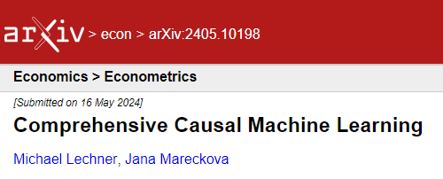
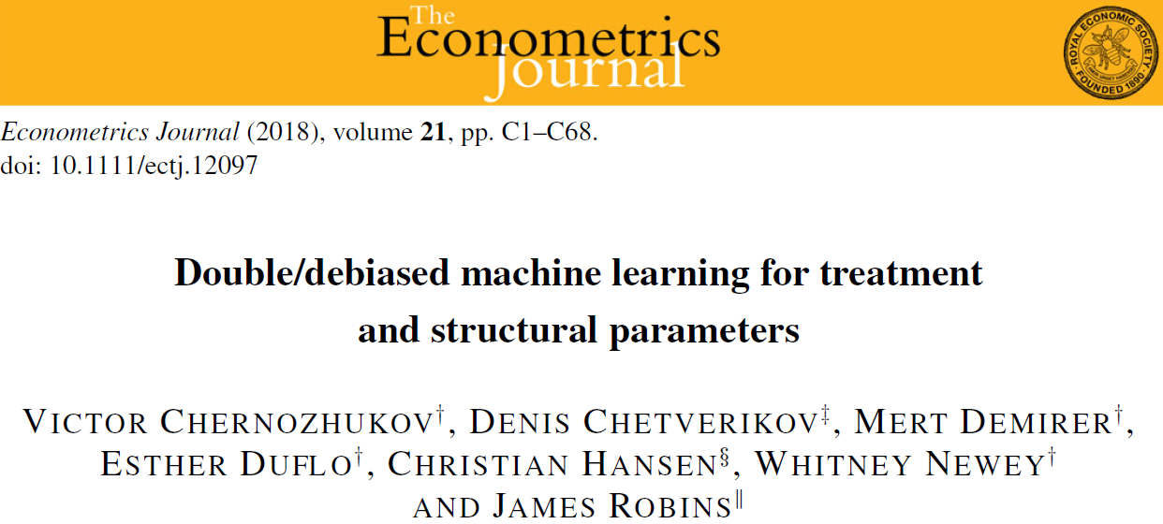
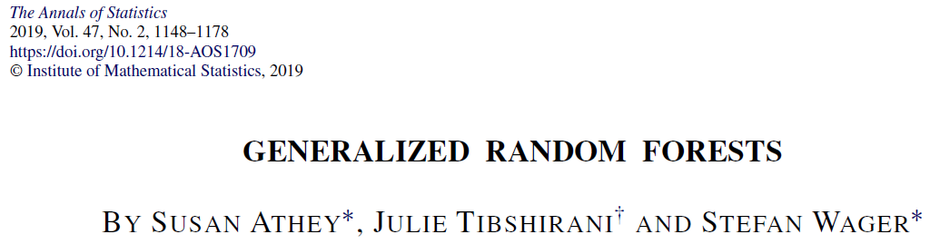
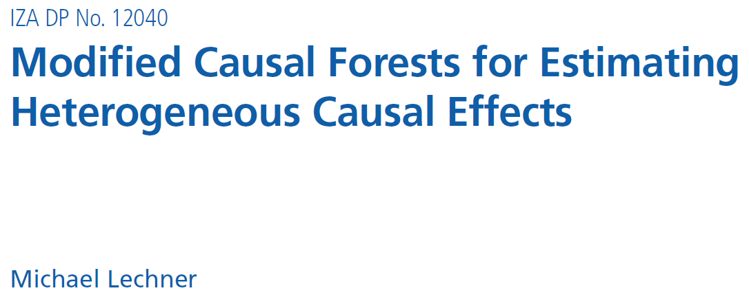
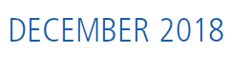
Comprehensive Causal Machine Learning
Double/debiased Machine Learning
Common element: Doubly Robust Score
Generalized Random Forest
Common element: Generalized Random Forest structure
Modified Causal Forest
Common element: Causal Forest
Aggregate effects obtained by aggregation of finer-grained effects

Slide 17


Slide 18
1 | Introduction
2 | Machine Learning vs Causal Machine Learning
3 | Double Debiased Machine Learning
4 | Causal Trees & Forests
5 | A comparison of Comprehensive Causal Machine Learners
6 | Optimal Policy & Algorithmic Decision Making
7 | Conclusions & outlook

Slide 19
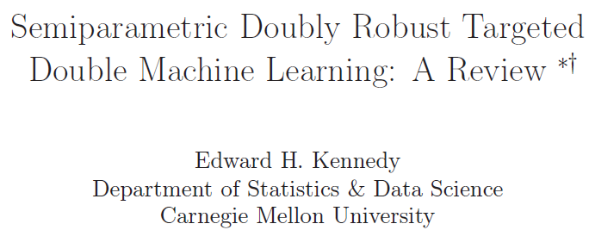
Nice technical survey

Slide 20
Comprehensive methodologies | 1
Double / debiased machine learning (DML): Theory
Main idea
Use specific moment condition that fulfils Neyman Orthogonality Condition
Here: Dependence of moment condition on propensity score (P(D=1|X=x) & outcome equations (EY|X=x, D=d)) is such that small errors in those (nuisance) functions do not affect distribution of estimator
1st step: Use ML to estimate nuisance functions
2nd step: Solve moment conditions given estimated nuisance functions (X-fitting)
This principle is applicable to many estimation problems
It is related to Double Robustness (in treatment effect estimation)
DR in parametrics: OK if propensity score or outcome equations are misspecified
DR in CML: OK if propensity score & outcome equations are approximated with small enough errors

Slide 21
An alternative modelling approach | Notation
Common in this literature to use (slightly) more structure
Assumption very similar to CIA as defined before
Without putting additional structure on m(X) & g(D,X), the model is very general (& allows for almost general heterogeneity)

Slide 22
Double machine learning for treatment effects | 1
Basic idea
Step1 : Estimate unknown functions g₀(.) & m₀(.) by standard predictive ML
Combine these estimates so that the estimator for the treatment effect has good properties
Based on moment conditions that fulfil the Neyman orthogonality condition
W=(Y,D,X);
Assume there is a low-dimensional vector of structural parameters θ₀
Vector η₀ of nuisance parameters may be high dimensional
Let ψ(W, θ, η) be a function
Moment condition:
Neyman orthogonality condition (NOC):

Slide 23
Double machine learning | 2
A Gateaux derivative is a directional derivative in vector spaces that may have infinite dimension
The NOC implies robustness of the resulting estimator of θ to small estimation errors in η
Thus, a 2-stage estimator is possible that
(1) obtains sufficiently precise estimates of η (by machine learning)
(2) solves the moment condition for θ given the estimated η
The influence functions derived by Hahn (1998) fulfil these 2 conditions → leads to efficient estimation for ATE, ATE(d)
Note: All semi-parametrically efficient scores share the NOC, but not all scores that have the NOC, are efficient
Source: Wikipedia, May, 17, 2019
Fisher, A., E. H. Kennedy (2019): Visually Communicating and Teaching Intuition for Influence Functions, arXiv:1810.03260v2

Slide 24
Double machine learning | 3
ATE
Analogous expression for the ATE(1), ATE(0)
The double robustness property (leading to the NOC) turns out to be particularly useful in this context
Small estimation errors for μ(d,x) & p(x) can be ignored

Slide 25
Double machine learning | 4
Estimator suggested by CCDDHNR (2018):
The nuisance functions are estimated without using observation ‘i’
cross-fitting (to avoid overfitting)
simplifies asymptotics, as observed & predicted quantities are uncorrelated

Slide 26
Double machine learning | 5
CCDDHNR (2018) suggest to implement this estimator by k-fold cross-validation (i.e., generalized ‘cross-fitting’)
Repeat for every fold k=1:K
Estimate nuisance functions on the remaining K-1 folds (without using data from fold k)
Estimate ATE for fold k (by evaluating the estimated nuisance function with the data of fold k)
Final estimator is computed as average of these K estimators
Estimator is consistent, efficient, √N-convergent & asymptotically normal
Approximate standard error of √N x estimator is computed as

Slide 27
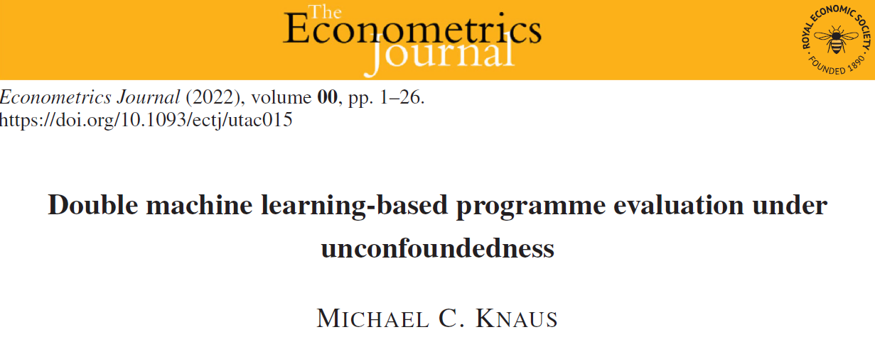
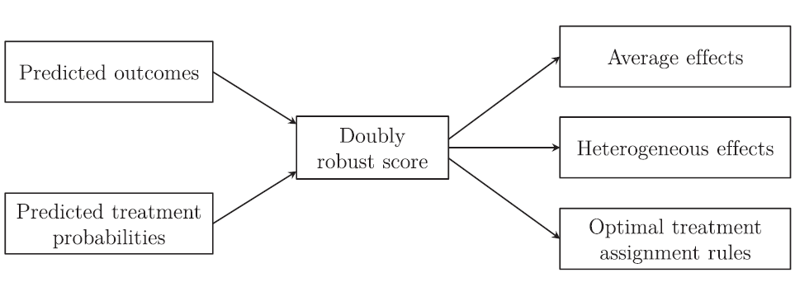
The central role of the (cross-fitted) Doubly Robust Score
DML for binary treatment
Additional smoothing step

Slide 28
DML for binary treatment | Averages of DR score
ATE
GATE (z-discrete)
Identical estimator: OLS with z-specific dummy variables
Regular OLS standard errors valid

Slide 29
DML for binary treatment | DR learner
GATE (z continuous) & IATE(x)
If f(x) parametrically specified & estimation by OLS
Drawback: Not robust to misspecification of f(x)
If linear & OLS: Best linear predictor of CATE(x)
If Z continuous, or of high-dimension & f(x) is nonparametrically estimated, or by ML
Estimator is conjectured to be consistent
Inference known only in special cases (e.g., continuous Z → nonparametric rate → Lechner, Zimmer, 2024)

Slide 30
Double machine learning | 6
Pro’s
Theoretical properties known & attractive
Each ML estimators may converge at a speed of only N^{1/4}
Chose ML estimator known to work ‘best’ for particular prediction problem
Estimators with slower & faster speeds than N^{1/4} can be combined
Additional uncertainty due to sample splitting during cross-validation can be accounted for by repeating the estimation with different splits & analysing the resulting distribution of estimated ATEs
This uncertainty may be accounted for when constructing confidence intervals
Con’s
Weighting by p(x) may be unstable if estimated p(x) gets close to 0 or 1
If ML estimators predicts p(x) well so as to (almost) separate treated & controls
If (real) common support is weak (leading to first point)
Limited theoretical guarantees high-dimensional CATE(x) rather unexplored (DR-Learner)

Slide 31
Extensions of DML theory (examples)

Slide 33
1 | Introduction
2 | Machine Learning vs Causal Machine Learning
3 | Double Debiased Machine Learning
4 | Causal Trees & Forests
5 | A comparison of Comprehensive Causal Machine Learners
6 | Optimal Policy & Algorithmic Decision Making
7 | Conclusions & outlook

Slide 34
Estimation of
Causal problem is transformed into prediction problem(s)
Machine learning (ML) methods are good with prediction problem(s)
Goal is to estimate a difference of 2 conditional expectations in 2 (nonrandom) populations defined by observed treatment status
Nonstandard ML problem
‘Ground truth’ not observable (‘true’ dependent variable unobservable)
Selection into these (sub-)populations by ‘selection process’
Propensity score, p_{m} (x), affects properties of estimators by changing the …
observed joint distribution of X & Y in the subpopulations (confounding)
sample sizes of subpopulations (bias & precision)

Slide 35
General remarks on predicting IATE(x)
The ML goodness-of-fit perspective on this problem
The last term (Mean Correlated Error) cannot be easily estimated
If x is continuous, y_{i}’s in treatments 1 & 0 with same value of x will not be observed
Different estimation methods approximate MCE() differently

Slide 36
Remarks on this prediction problem | 3
The 2 estimators of the 2 regression curves are tied together
Positively correlated estimation errors of the regression curves matter less
MCE leads to biased estimation of the 2 regression curves
If estimation errors are correlated across treatments, this will be a better estimator for the difference despite being a worse estimator for the 2 regression curves
ML principles may be modified
to account for this ‘tying together’ of the regression curves
Different estimators use different approximations of the MCE()
to remove bias of the estimator (needed for inference)

Slide 37
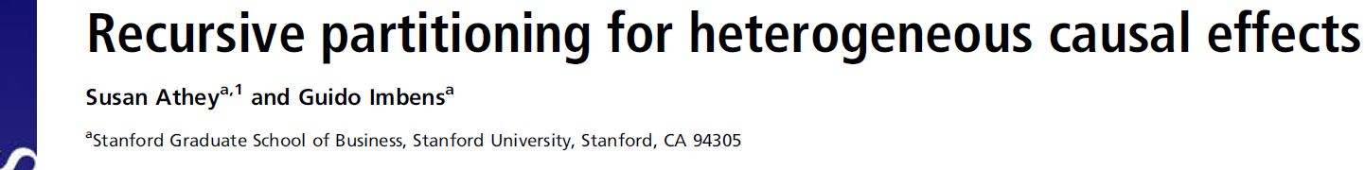
Basic principles of Causal Trees
Homogeneous-in-X strata → no-selection-bias → difference of Y between treated & controls is ‘good’ estimator
Approximation of min(MSE) used: max(Var(IATE(x)))
Estimator of IATEs(x): Difference of (weighted) within leaf treatment-control outcome means
Honesty
Different data to build forest & to populate the final leaves with y_{i}
Avoidance of overfitting
Debiasing & allowing for inference
Currently, rarely used for estimation
Trees tend to be unstable & to have too much variance
Outperformed by Causal Forests

Slide 38
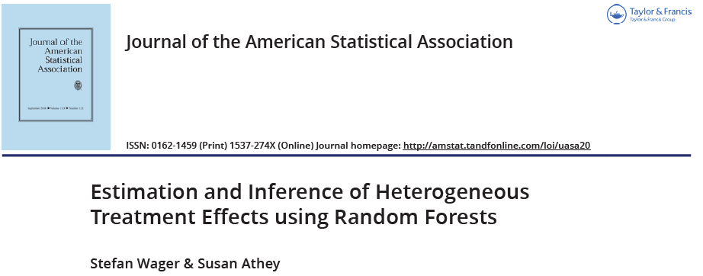
Basic principles of Causal Forests | 1
Use deep causal trees
Low bias, but high variance
Use Random-Forest-like splitting algorithm with adapted splitting rule
Different Causal Forests use different splitting rules that try to approximate the MSE of the IATE
Maximise treatment effect heterogeneity: CF (Wager, Athey, 2018), grf (Athey, Tibshirani, Wager, 2019)
Approximate estimation errors directly: mcf (Lechner, 2018)
Honest estimation to avoid bias & getting inference
Different data to build forest & to populate the final leaves with y_{i}

Slide 39
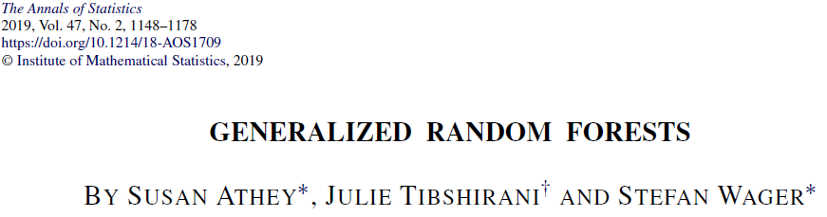
Generalized Random Forests | 1 | Estimation of IATE
Extension of Random Forest to nonparametric local GMM
Weights obtained from gradient-based splitting rule → maximise treatment effect heterogeneity
Honesty (instead of cross-fitting)

Slide 40
Generalized Random Forests | 2 | Estimation ATE & GATE
ATEs & GATEs are estimated through additional regressions using grf score function
dml-like score function:
ATE:
GATEs
Regress score on Z
Heteroscedasticity-robust standard errors of OLS regression

Slide 41
Properties of estimator to be attractive in practice
The Applied Researchers’ Wish List
Point estimators & inference for all effects
All relevant aggregation levels
Multiple treatments
Desirable statistically properties for reasonable N
RMSE better than difference-of-regressions estimator
Good basis for reliable inference: Smallish bias & normally distributed estimator
Maybe at the cost of some efficiency loss
Theoretical asymptotic guarantees for point estimator & inference
Consistency, asymptotic normality for all parameters of interest
Consistent estimator of standard errors / valid inference
Computationally not too demanding
No separate estimations for different aggregation levels

Slide 42

Modified Causal Forest | Main ideas
The mcf is a modification of the Causal Forest by Wager & Athey (2018)
Important modification
Splitting rule based on alternative proxy for MSE
Nearest neighbour approximation of the MCE
Penalty function to favour split that lead to more extreme propensity scores in leaves
to further reduce selection bias
Representation of causal effect as weighted mean of y_{i}’s is used for inference
Requires different implementation of sample splitting
ATE & GATE(z) are obtained by aggregating IATE(x)’s

Slide 43
Objective function | MCE | 2
Optimize sample splits in training sample w.r.t.
Unknown counterfactuals substituted by nearest neighbours using main diagonal of Mahalanobis distance
Matching on the propensity score(s) is a bad idea: MCE is not (directly) related to selection bias
Matching on predictive scores works: Computationally more expensive than Mahalanobis matching as predictive scores need to be estimated by ML

Slide 44
Objective function | Penalty term
Main idea
Add penalty term that penalizes splits with similar treatment probabilities
Reduces selection bias effectively
Example of a penalty function
= 0 if split leads to a perfect prediction of the probabilities in the daughter leaves
= λ if treatment probabilities in daughter leaves are the same
Cheap to compute as it only counts the treatments in any potential split

Slide 45
Weights for aggregation & inference | 1
Estimators coming from RF/CF can be expressed as weighted outcome means
Estimators for intermediate levels can be obtained by aggregating weights
Computationally convenient
Inference
Weight-based inference
Same principle for all aggregation levels
Sample splitting required

Slide 46
Inference | General weight-based estimators | 1
Background
Structure of estimator:
Law of total variance (Var(Y)=E[Var(Y|X)]+Var[E(Y|X)] ):
i.i.d. sampling:
RF: are the training data to build RF

Slide 47
Inference | General weight-based estimators | 2
Background
If i does not belong to training data, and observations are i.i.d., y_{i} is independent of
This leads to a simpler formula for the variance:
$${\hat{w}}_{j}$$

Slide 48
Inference | General weight-based estimators | 3
… suggests to use the following estimator for the variance:
These are 2 1-dimensional problems. Therefore, standard non-parametric estimators are fast & accurate for &
Some estimation noise will be washed out by averaging these non-parametric estimators

Slide 49
Inference | General weight-based estimators | 4
Background
Implementation
k-nearest neighbour estimators (k increases slowly with N)
Computationally convenient (fast)
Alternatively, Nadaraya-Watson estimation
Bodory, Camponovo, Huber, & Lechner (2020) investigate k-nearest neighbour estimators to obtain these weights
they found good results in a binary treatment setting for the ATET
Finite sample properties of different version not yet investigated
Clustering can also ‘easily’ be incorporated
Shortcoming: Lack of theory for choosing smoothing parameters

Slide 50
Inference | General weight-based estimators | 5
Background
Final remarks on inference
Would be nice to have some asymptotic theory for the estimators of conditional means & variances to get consistency conditions (problem a bit more non-standard as weights come from a machine learner)
The more spread-out the weights are (as for ATE & GATEs), the better the inference, as it may not require consistent estimation of ,
With the less spread-out weights of IATE, the estimator will much more benefit from good estimation of ,
Open issue: Are the choices for k also reasonable for IATE (that removes less noise by averaging), or do we need larger or smaller k?

Slide 51
Estimator of (G)ATE as function of estimator of IATE
Background

Slide 52
Implementation of estimation & inference | 1
Background
1) Split the estimation sample randomly into two parts of equal size (sample A and sample B)
2) Estimate the trees that define the random forest in sample A
Modified Causal Forest: Estimate the same forest for all treatment states jointly. Before building the first tree, for each observation in each treatment state, find a close ‘neighbour’ in every other treatment state and save its outcome (to estimate MCE). The splitting rule is based on minimising the overall MSEs, taking account of all MCEs & and penalty term

Slide 53
Implementation of estimation & inference |2
Background
3) Apply the sample splits obtained in sample A to all subsamples (by treatment state) of sample B and take the mean of the outcome in the respective leaf as the prediction that comes with this Causal Forest
4) Obtain the weights from the estimated Forest by counting how many times an observation in sample B is used to predict IATE(x) for a particular value of x.
5) Aggregate the IATEs to GATEs by taking the average over observations in sample B with the same value of z and treatment group Δ. Do the same aggregation with the weights to obtain the weights for GATEs.
6) Do the same steps as in 5) to obtain the ATEs, but average over all observations in treatment group Δ.

Slide 54
Implementation of estimation & inference |3
Background
7) Compute weight-based standard errors. Use these estimated standard errors together with the quantiles from the normal distribution to obtain critical values (p-values).

Slide 55
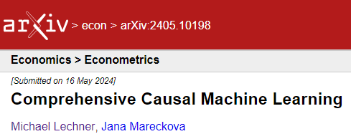
Modified Causal Forest | 3 | Asymptotic properties
ATE & GATE & IATE
Consistent, asymptotically normal

Slide 57
1 | Introduction
2 | Machine Learning vs Causal Machine Learning
3 | Double Debiased Machine Learning
4 | Causal Trees & Forests
5 | A comparison of Comprehensive Causal Machine Learners
6 | Optimal Policy & Algorithmic Decision Making
7 | Conclusions & outlook

Slide 58
Summary of theoretical properties
ATE
All estimators are consistent, asymptotically normal
dml & grf are efficient
mcf: ATE is sum of IATEs
GATE
All estimators are consistent, asymptotically normal (Z discrete)
mcf: GATE is sum of IATEs in subsamples defined by values of Z
IATEs (finite dimensional X)
mcf & grf are consistent, asymptotically normal
dml (DR-learner) is consistent, asymptotically normal for parametric approximations (e.g., best linear predictors)

Slide 59
Goal | 1
Comprehensive analysis of behaviour of grf, dml, mcf (& in different versions, OLS) in finite (but larger) samples
Quality of point estimates & inference procedures
Computationally very demanding
Many scenarios needed to see if some method breaks down in certain situations

Slide 60
General considerations | 1
Simulations (Econometrics) vs. benchmark studies (Machine learning)
Difficult to use for inference (requires replications) ➔ simulations
Empirical Monte Carlo Study (EMCS) vs. synthetic design
EMCS somewhat more realistic for special case
We want to vary very many characteristics → synthetic design
Type & quantity of covariates, # of treatments , effect heterogeneity, degree of selectivity, sample size, functional forms, influence of covariates on outcomes & heterogeneity, share of treated
Fixed or random features (X)
Only fixed-X design allows to analyse distributions of IATEs(x) for given x
Random-X design better reflects distribution theory ➔ fixed X

Slide 61
Simulation design | 1
Repeat R times
Draw 2 data sets of size N
Data set 1 (to train forest): contains D, Y, X
Data set 2 (to predict effects): contains IATE(x), X
Estimate effects & standard errors
Save results
Compute performance measures
1st to 4th moments, bias, MSE, absolute error, bias of standard error, coverage probability

Slide 62
Goal | 1
Compare finite sample behaviour of dml, grf, mcf
Quality of point estimates & inference procedures (out-of-training sample)
Synthetic Monte Carlo study with different data generating processes
Sample size: N=2’500 & 10’000
Covariates
# of covariates in data: p = 10, 20, 50
# of covariates in DGP (sparsity): k = 0.2 p, 0.5 p, 0.8 p
Type of covariates: Normal, uniform, dummy (pure & mixtures of different types)
Z: Continuous covariate split into 5, 10, 20, 40 groups
Treatment
# of treatments: 2, 4
Strength of selection (R² = 0, 10%, 42%)
Treatment shares: 25%, 50%
Potential outcomes
Y⁰: Sine function of linear index, R² = 0, 10%, 45%
Y¹: Y⁰ + IATE + noise
IATE: 0, Linear, quadratic, logistic, step functions

Slide 63
Summary | 1
dml
Dominates when # of groups is small & selectivity is not too large
Performance may drastically deteriorate for a larger # of groups or stronger selectivity
Not useful for IATEs
grf (pre-centred)
Similar good than dml when # of groups is small & selectivity is not too large
Performance drastically deteriorate for a larger # of groups (& somewhat for strong selectivity)
Good performance for IATE

Slide 64
Summary | 2
mcf (pre-centred)
Less efficient when # of groups is small & selectivity is not too large
Much less affected by larger # of groups & stronger selectivity
Overall robust (& competitive) behaviour

Slide 65
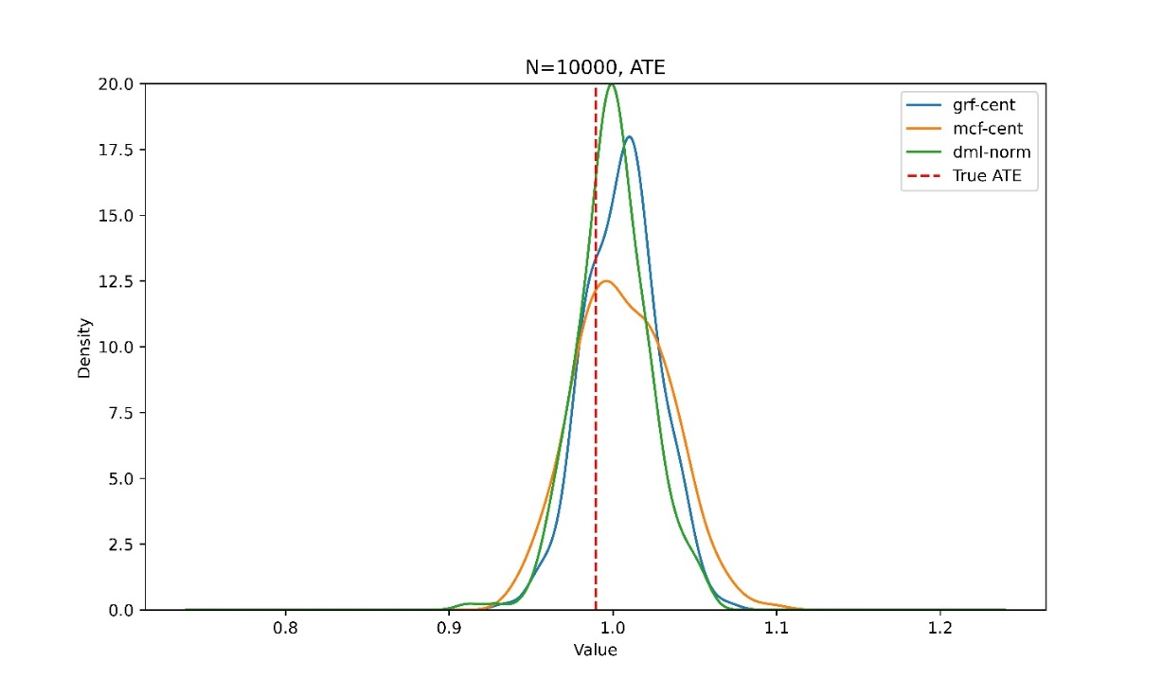
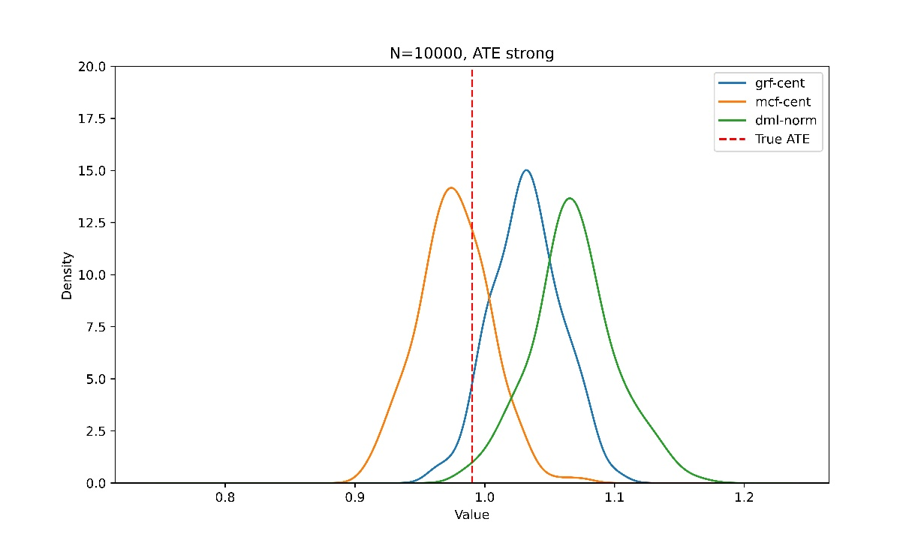
ATE estimator may be sensitive to different levels of selectivity
Medium selectivity (R²=10%)
Strong selectivity (R²=42%)
dml
Bias (& MSE) is even larger for smaller sample

Slide 66
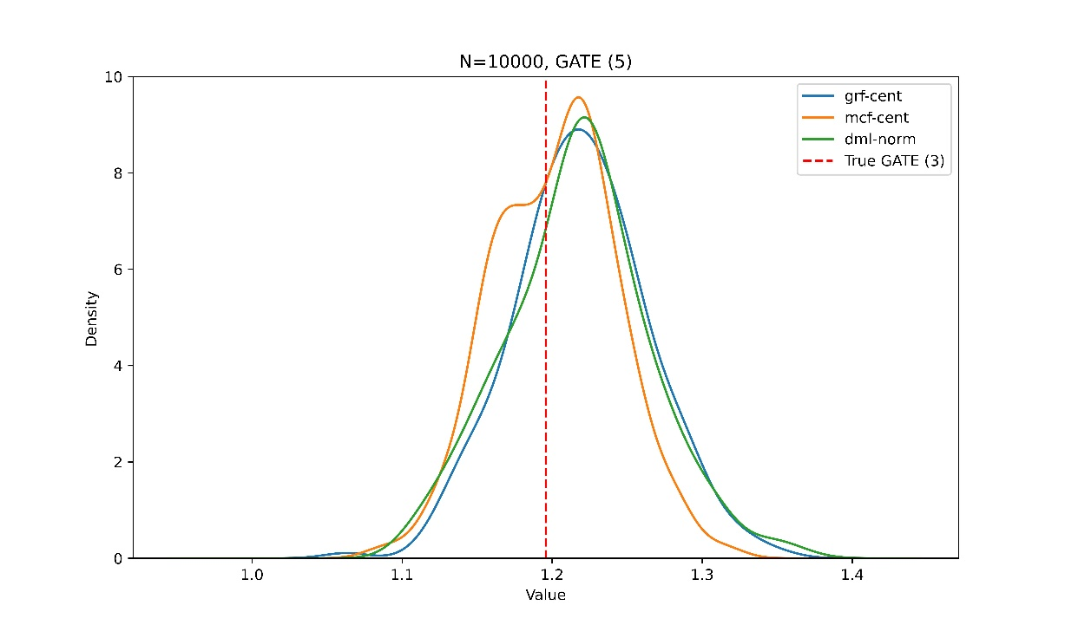
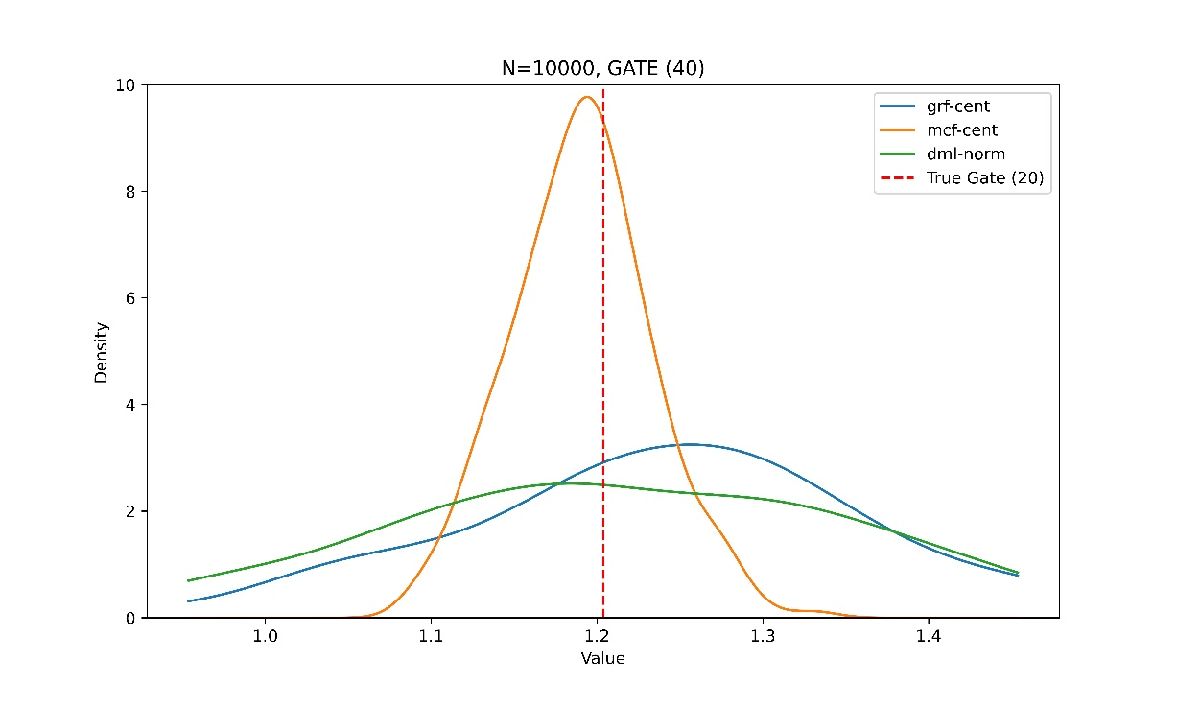
GATE estimator may be sensitive w.r.t. different # of groups
GATE with 5 groups
GATE with 40 groups
grf
dml
Variance (MSE) is even larger for smaller sample

Slide 67
Recommendations for empirical work
Large sample available (standard error reduction not a major concern)
mcf
Smaller sample (standard error reduction is important)
ATE, GATE (few groups): dml or grf (robustness check with more robust mcf)
GATE (many groups): mcf
IATEs: grf or mcf
A note on computation
User friendly packages available in Python & R (& Stata for dml)

Slide 68


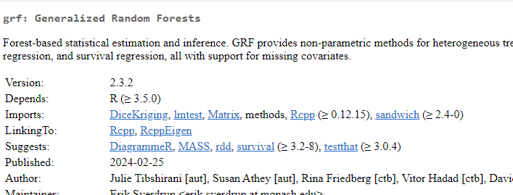
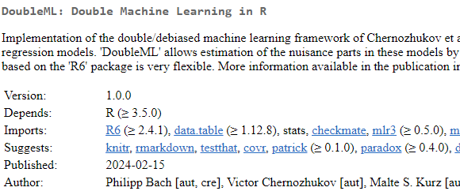
Some packages
…

Slide 69


Slide 70
1 | Introduction
2 | Machine Learning vs Causal Machine Learning
3 | Double Debiased Machine Learning
4 | Causal Trees & Forests
5 | A comparison of Comprehensive Causal Machine Learners
6 | Optimal Policy & Algorithmic Decision Making
7 | Conclusions & outlook

Slide 71
Optimal policy & individualized treatment rules | 2
Holy grail & final culmination of Causal Machine Learning
So far: We estimated heterogeneous causal effects
Now: We use this knowledge to improve decisions
This may also lead to changes in the estimation of the heterogenous effects
New & rapidly developing literature in all fields
This lecture focuses mainly on the following papers
Manski (2004): Statistical Treatment Rules for Heterogeneous Populations, Econometrica, 72
Athey, Wager (2020): Policy Learning with Observational Data, Econometrica
Kitagawa, Tetenov (2018): Who Should Be Treated? Empirical Welfare Maximization Methods for Treatment Choice, Econometrica, 86, 591–616
Zhou, Wager, Athey (2019): Offline Multi-Action Policy Learning: Generalization & Optimization, arXiv

Slide 72
Optimal policy & individualized treatment rules | 3
Economics
Active labour market policy: Which type of unemployed should be assigned to which type of active labour market programme (subject to budget constraint)?
Regional policy: Which region gets which type of subsidized infrastructure investment?
Business
Private investment decisions: In which type of machinery should we invest to maximise profits?
Medicine
Personalized medicine: Which patient gets which type of treatment?
…

Slide 73
Optimal policy & individualized treatment rules | 4
Naïve Rule
Estimate IATEs by some good estimator & allocate treatment with highest estimated potential outcome
Naïve rule may have limitations
Estimation problem for IATE & optimal policy (allocation) rule differ
MSE minimisation vs. classification type problems
Does not respect possible budget constraints
Algorithms with proven properties are mainly available for experiments & selection-on-observables
Baseline settings in rich data environments
Other identification strategies not much trusted outside economics (IV, …)
Other IS may identify effects only for (unknown) compliers (IV, RDD) or treated (DiD)

Slide 74
Notation

Slide 75
Optimal policy & minimum regret | 1
Remarks
Maximising Q(π) is equivalent to minimising R(π) (minimal regret)
Minimizing regret depends on high quality estimates of PO
Nevertheless, this is closer to classification than to regression problems
Example:
Optimal policy: Estimation error for x=a does not matter, for x=b it matters hugely
Regression-type: They both matter (by how much, depends on distribution of X)

Slide 76
Minimax regret
Usually, optimal allocation such that it minimizes the largest possible regret over all possible data generating processes
Usually, this is the best possible property that can be provenly attributed to a certain policy allocation algorithm
However, difficult (impossible?) to achieve with feasible estimators
Recently advances by considering restricted policy classes (reducing complexity of policy rules)
More on such approaches in next section

Slide 77
Optimal policy & individualized treatment rules | 1
Further remarks
Major challenges are
Estimating expected potential outcomes (or the elements of an alternative policy score) precisely
Finding best policy within potentially huge numbers of possible allocations of treatments
Could be particularly demanding (statistically & computationally) when there are …
many covariates
many treatments
‘difficult’ constraints
dynamics, i.e. sequences of treatments

Slide 78
Online vs offline policy learning
Offline policy learning
Experimental or non-experimental data is already available
Use this data to learn good policy rules to apply in future
Good approach if data is large & informative & world is stationary
Online policy learning
Gather new data (usually experimental)
Allocate such as to …
get good policy (exploitation)
get better estimates (possibly suboptimal allocation in smallish groups; exploration)
This trade-off needs to be optimized to get good long-term results
Large & growing literature (Bandits) on how to best do this

Slide 79
Kitagawa-Tetenov (2018) | 1
Background
Binary treatment, known propensity score
Empirical welfare maximisation method
Maximise sample analogue of average social welfare (sum of potential outcomes)
Features
Constraints on policy
Ethical etc. constraints
Budget → units per treatment
Simple rules based on few ‘scores’
Properties for known propensity score
√N - convergence, minimax optimality under fairly general conditions (& unconfoundedness)

Slide 80
Kitagawa-Tetenov (2018) | 2
Background
Structure of estimator
Let π(x) be the set of values of x for which the treatment is assigned
This set has lower dimension than x (restricted policies)
The Empirical Welfare of a policy is given by
Optimal policy:

Slide 81
Kitagawa-Tetenov (2018) | 3
Background
Estimation: Solve empirical analogue
If the link of x to the policy is not substantially restricted, this estimation poses huge computational (as well as statistical) challenges (Mixed Integer Linear Programming)

Slide 82
Athey & Wager (2020) | 1
Binary treatment (essential)
Selection-on-observables (essential)
Double machine learning-type-of-argument incorporated
Restricted class of policies
Linear-in-x-rules (not too many x) & (shallow) decision trees
Leads to much better theoretical guarantees than more complex policies
Simple rules that depend on a limited number of covariates may be more easily accepted by decision makers (‘interpretable AI’)
DML & restricted class of policies leads to good theoretical guarantees

Slide 83
Athey & Wager (2020) | 2
AW2019 propose two-step procedure
1) Estimate doubly robust policy score
2) Find best allocation by minimizing regret given the score

Slide 84
Athey & Wager (2020) | Step 1
Conditions
The 3 consistent 1st stage estimators converge at least at rate N^{1/4}
Many ML procedures achieve this rate (RF, Lasso, some NN, etc.)
Observation i must not be used in 1st stage → cross-fitting
May be implemented via k-fold cross-validation
This is double machine learning used for policy analysis

Slide 85
Athey & Wager (2020) | Step 2
Use policy score to find best allocation in restricted class
Not a convex problem ➔ may be computationally very demanding, depending on the policy class considered (& type & dim of X)
However it has an interpretation as a weighted classification problem with sample weights λ_{i} & response variable H_{i}
Thus, AW19 propose to train a (weighted) classifier by standard ML methods

Slide 86
Zhou-Athey-Wager (2022) | 1
Extension of AW19 to multiple treatments
1) Estimate doubly robust policy score (with cross-fitting)
2) Find best allocation by minimizing regret given the vector of scores

Slide 87
Zhou-Athey-Wager (2022) | Step 1
Conditions
The 2 M+1 consistent 1st stage estimators converge at least at rate N^{1/4}
Many ML procedures achieve this rate (RF, Lasso, etc.)
Observation i must not be used in 1st stage → cross-fitting
May be implemented via k-fold cross-validation
This is double machine learning used for policy analysis

Slide 88
Zhou-Athey-Wager (2022) | Step 2
Use policy score to find best allocation in restricted class
Not a convex problem ➔ may be computationally very demanding, depending on the policy class considered
Interpretation as weighted classification problem seems not to work
They provide 2 algorithms for decision trees
Exact solution via mixed integer programming
Very, very computational intensive
Approximate solutions via a limited number of trees
Computationally (sort-of) efficient, but does not allow for constraints
Cox, Lechner, Boolens (2019) modify their algorithm to allow for capacity constraints

Slide 89
Practical problems | 1
Overfitting
Optimal policy too closely targeted to sample at hand → may not generalize
Split sample randomly → see whether same recommendations emerge in all sample splits (cross-validation type arguments)
Incorporating ‘difficult’ constraints
In particular for trees, it seems difficult to introduce them without forgoing efficiency
See Cox, Lechner, Boolens (2022) for a proposal

Slide 90
Extensions & discussion points
Issues
Explainability
Selection of decision variables
Fairness
Computational efficiency
Policy trees are NP-hard
Extensions
Large literature on dynamic treatments & continuous treatments

Slide 91
Estimation of IATE and optimal policy: Some ‘after-thoughts’
Background
Decision making & effect estimation are different tasks (classification vs. regression)
Thus, they have different objective functions & which should give better results for the task they are optimized for
But, if we know potential outcomes (or estimate them without error), assigning treatments according to potential outcomes is optimal
Biases in the policy scores (or consistent estimation of IATEs or potential outcomes) do not matter if these biases do not change the order of the potential outcomes
Thus, in finite samples it could be that …
Longer data (with some missing confounders) may be preferable to wider data with all confounders (unclear however when this is true)
Using precisely estimated potential outcomes (like from the MCF or similar) could give better results than using the DML based policy scores → to be investigated further
Nice discussion in Fernández-Loría, Carlos, Foster Provost (2021): Causal Decision Making and Causal Effect Estimation Are Not the Same... and Why It Matters, arXiv:2104.04103, INFORMS Journal of Data Science

Slide 93

1 | Introduction
2 | Machine Learning vs Causal Machine Learning
3 | Double Debiased Machine Learning
4 | Causal Trees & Forests
5 | A comparison of Comprehensive Causal Machine Learners
6 | Optimal Policy & Algorithmic Decision Making
7 | Conclusions & outlook

Slide 94
Conclusions
Comprehensive causal machine learning has many advantages in applied work
Workflow monitoring
Internal consistency of causal effects obtained for different aggregation levels
The modified causal forest is robust estimator for all aggregation levels
Python module available
The mcf Python module provides also methods for optimal policy / algorithmic decision making

Slide 96
Tomorrow morning Application of these methods to the evaluation of training programmes in Flanders
Michael Lechner
Swiss Institute for Empirical Economic Research (SEW) University of St. Gallen | Switzerland

